Slide 1
Things that every JS developer should know
Rachel Appel | JetBrains
http://rachelappel.com
rachel@rachelappel.com
@RachelAppel

Slide 2
What’s in this talk?
Basic things are important for every JS developer
So are some advanced things

Slide 3
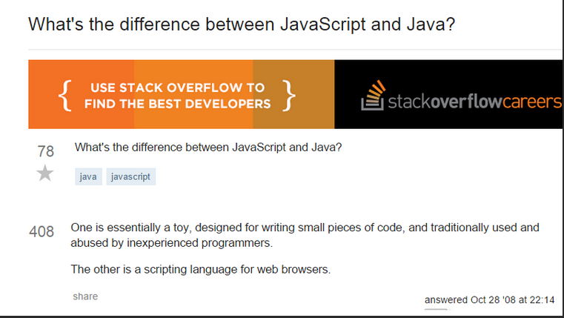

Slide 4
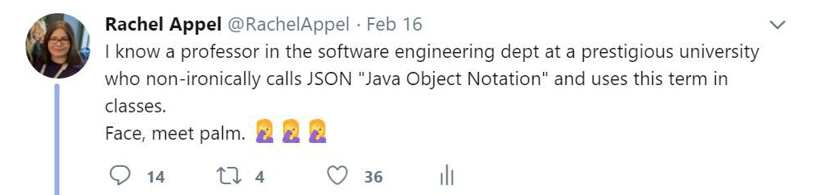
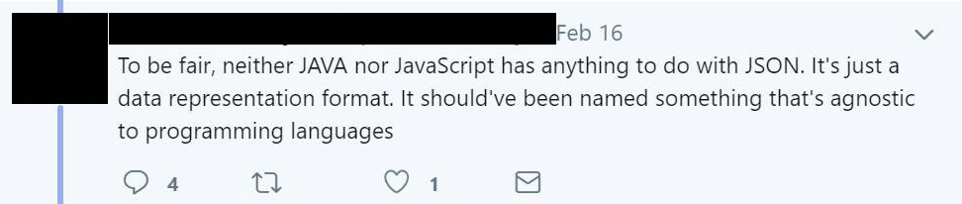
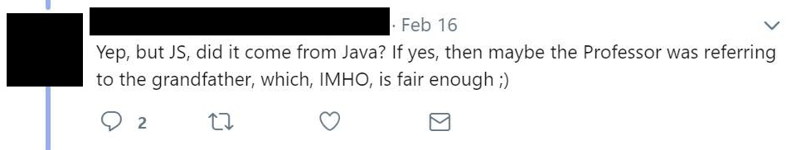
It does. Its origins are from JS.
LOL WAT?!?
Seriously WTF?!?

Slide 5
Data Types
There really are data types in JavaScript!
But does JavaScript care?
Value types (aka primitives)
Number, string, Boolean, null, undefined, object, symbol
Reference types
Objects and arrays
Notes:
https://www.youtube.com/watch?v=9ooYYRLdg_g REF v VAL types
typeof operator, in particular, that it returns “object” for null.
Special numeric values
Infinity, -Infinity and NaN
Null
It is not a reference to a non-existing object.
It is not a null pointer
It is a special value that means: dunno, unknown, nothing, empty, nada

Slide 6
Functions & Scope
Callable objects
Key-value dictionaries under the hood

Slide 7
Global
<script src="1.js">
var a, b, c
<script src="2.js">
var a, b, c
<script src="3.js">
var a, b, c
<script src="4.js">
var a, b, c
Window object
Global namespace pollution
Module/Module Reveal Pattern

Slide 8
var vs let
var is function scoped
Can declare globally or locally
let is block scoped
Declarations are limited in scope to the block
Notes:
let allows you to declare variables that are limited in scope to the block, statement,or expression on which it is used. This is unlike the var keyword, which defines a variable globally, or locally to an entire function regardless of block scope

Slide 9
A closure is a special kind of object that combines two things: a function, and the environment in which that function was created. The environment consists of any local variables that were in-scope at the time that the closure was created.
Notes:
A closure is a special kind of object that combines two things: a function, and the environment in which that function was created. The environment consists of any local variables that were in-scope at the time that the closure was created.

Slide 10
Lexical scope: captures variables from parent scopes

Slide 11
arrow functions and closures
Arrows don’t create their own value for ‘this’
They use the enclosing block
Notes:
In classic function expressions, the this keyword is bound to different values based on the context in which it is called. With arrow functions however, this is lexically bound. It means that it usesthis from the code that contains the arrow function.

Slide 12
Inheritance
Prototype-base inheritance, changing the prototype of an object.
ES6 classes and extends
defineproperty

Slide 13
Arrays
Is it a true Array?
No dimensions, per se
No out of bounds errors
typeof calls it an object
[] vs Array
Notes:
Arrays in JS aren't real arrays, they're phony
no dimensions
no out of bounds errors

Slide 14
Smooth Operators
==
===
!=
!==
Notes:
JavaScript has two sets of equality operators, equal to (==) and exactly equal to (===) and their counterparts in negation (!= and !==). The exactly equals works the way you expect. If the two operands are of the same type and have the same value, then exactly equals produces true and its negative partner (!==) produces false. The plain equals, OTOH, see different data types and attempts to coerce the values (it's called type coercion) by using a set of many overly complex rules.
It's just not reasonable to memorize all these rules, especially if you are trying to create team standards from them. Therefore, since it's more accurate going with the exactly equals is the best option.
Let's see some of this JS equality or non equality as the case may be, in action...[demo]
THE TAKE AWAY: Use the === and !== opeartors as they give consistent and accurate results, more closely to what you might expect.
console.log(0 == '');
console.log(0 === '');
console.log(0 == '0');
console.log(0 === '0');
console.log(false == 'false');
console.log(false === 'false');
console.log(false == '0');
console.log(false === '0');
console.log(false == undefined);
console.log(false === undefined);
console.log(false == null);
console.log(false === null);
console.log(null == undefined);
console.log(null === undefined);
console.log('\t\r\n' == 0);
console.log('\t\r\n' === 0);

Slide 15
Let's get to the truth of the matter
Truthy values
'false' (quoted false)
'0' (quoted zero)
() (empty functions)
[] (empty arrays)
{} (empty objects)
All other values
Falsey values
false
0 (zero)
'' (empty string)
null
undefined
NaN
Notes:
What constitutes something falsy in JS?
false.
0 (zero)
"" (empty string)
null
undefined
NaN (a special Number value meaning "Not a Number")
All other values are truthy, including "0" (zero in quotes), "false" (false in quotes), empty functions, empty arrays, and empty objects.
Falsey:
false
0 (zero)
"" (empty string)
null
undefined
NaN
Truthy
"false" (false in quotes)
"0" (zero in quotes)
() (empty functions)
[] (empty arrays)
{} (empty objects)
All other values

Slide 16
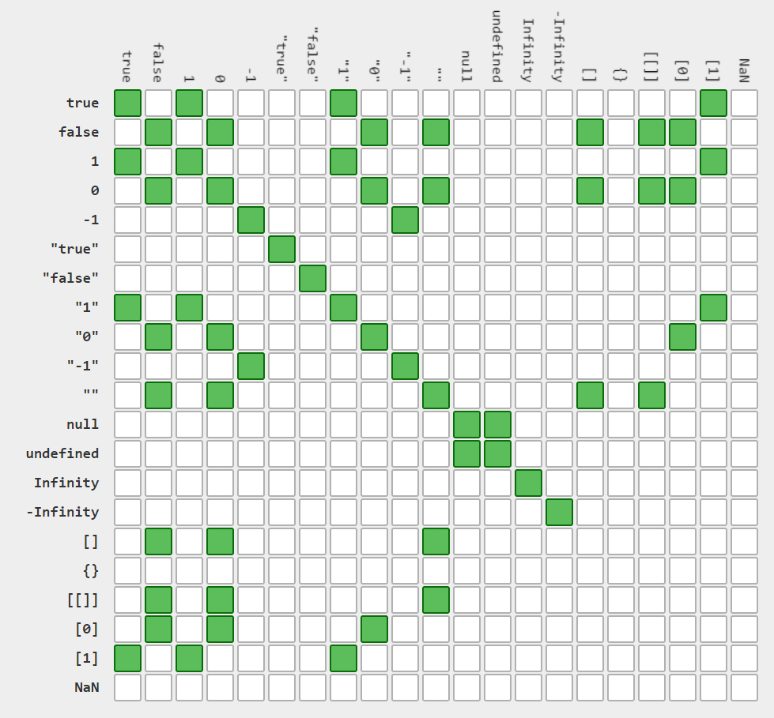
http://dorey.github.io/JavaScript-Equality-Table/
JavaScript
Equality
Table

Slide 17
Just what's up with this, anyway?
Typescript and this event obj
Notes:
Many folks try to treat "this" the same way that it works in other languages and their notion of this is normally static and at the class level. JavaScript is different though, as this works based on the context of the calling code.
Usually this belongs to the window, or global object, but it can also be the HTML element that has caused an event, for example, a button causing a click event. Then the function is owned by that source element and that element becomes this.
To go a little deeper
JavaScript functions run in an execution context that goes on the stack. The stack is an in memory storage location for variables and data.
Functions are also values, and they're treated like objects/values.
What this means is that each time another function runs, it gets pushed onto the stack and the context for "this" changes. That's unlike other languages where this is usually clearly defined.
So the value of this depends on 2 things: What kind of code is executing? (global, function, or eval) and the calling code.
*******
ES5 introduces the a way that you can set the value of "this" in a function, as the first argument of the call.
Here in the IE console we have a function called saySomething that accepts a string and logs both this and the string to form a sentence about what this . Let's see it work.
Now that I've run the function I can call it and make 'this' a programmer or a trekkie or katniss everdeen. Not that you'd wants strings to be this bit
function saySomething(thing) {
console.log(this + " says " + thing);
}
saySomething.call("A programmer", "Hello world");
saySomething.call("A Trekkie", "Live long and prosper.");
saySomething.call("Katniss Everdeen", "May the odds be ever in your favor");
saySomething.call("A ghost", "Boooooooo!");

Slide 18
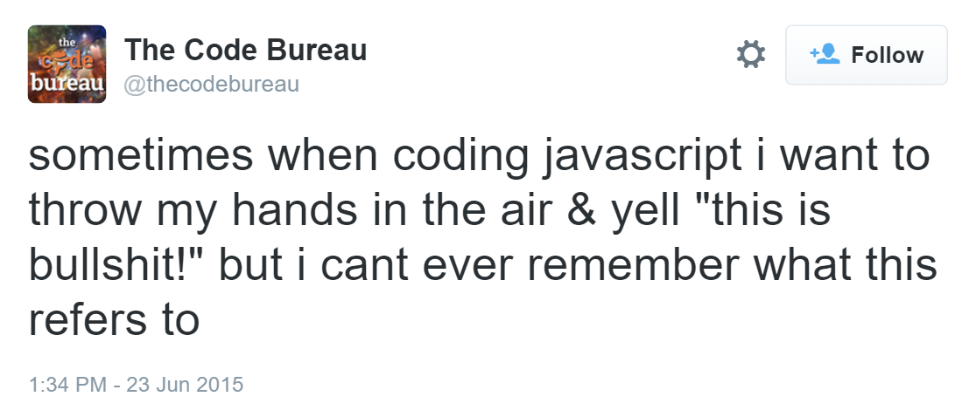
Sometimes when I'm writing JavaScript, I just want to throw my hands up and yell "This is bullshit!", but I can never remember what "this" is referring to.

Slide 19
Strict mode [ES5]
“use strict”
No more accidental globals
Must declare variables
Assignment issues are no longer silent. They throw errors
Function args with same name (yep, vanilla JS allows that)
Notes:
Strict mode is part of the ECMAScript 5 standard.
You can enable strict mode for a complete file or a single function:
Complete file: put the line "use strict"; at the beginning of the file. As a statement, this does nothing and will be ignored by legacy JavaScript interpreters.
Single function: using the mode for a complete file might break some functions in it, so by putting the line mentioned above at the beginning of a function, you can enable strict mode for it.

Slide 20
Seems legit
Look ma, no arguments!
var add = function() {
// do stuff
};
Wait, what? Seriously?
console.log(add(4, 4, “cat”));
Yeah it’s legit! This is JavaScript!
Notes:
It's not a main()
MENTION APPLYMENTION APPLY
MENTION APPLY

Slide 21
Garbage collection
Reachable
Local variables and parameters of the current function.
Variables and parameters for other functions on the current chain of nested calls.
Global variables.
Internal stuff
Notes:
https://javascript.info/garbage-collection
There’s a base set of inherently reachable values, that cannot be deleted for obvious reasons.
This algorithm looks out for objects which are unreachable from the root which is the JavaScript’s global object. This algorithm overcomes the limitations of Reference-counting algorithm. As an object with no references would be unreachable but not vice-versa.

Slide 22
Garbage collection
The basic garbage collection algorithm is called “mark-and-sweep”.
The following “garbage collection” steps are regularly performed:
The garbage collector marks roots.
It marks all references from them
It visits marked objects and marks their references. (everything is tracked)
Loop until unvisited refs happen
All objects except marked ones are removed.

Slide 23
Typescript, compilers, transpilers, tools
TypeScript
Babel
Webpack
Typescript can validate JS code – just run them the compiler, like a light linter

Slide 24
Thank you!

